Slide 1
.NET Framework

Slide 2
.NET Framework
The .NET Framework is a software framework developed by Microsoft that runs primarily on Microsoft Windows.
It includes a large class library called Framework Class Library (FCL)
Programs written for .NET Framework execute in a software environment named the Common Language Runtime (CLR).
The .Net Framework supports more than 60 programming languages such as C#, F#, VB.NET, J#, VC++, JScript.NET, APL, COBOL etc

Slide 3
.Net Framework Version History
.NET version | CLR version
1.0 | 1.0
1.1 | 1.1
2.0 | 2.0
3.0 | 2.0
3.5 | 2.0
4 | 4
4.5 | 4
4.6 | 4
4.6 | 4
The first version of the .Net framework was released in the year 2002.
The version was called .Net framework 1.0.
The .Net framework has come a long way since then, and the current version is 4.7.1.

Slide 4
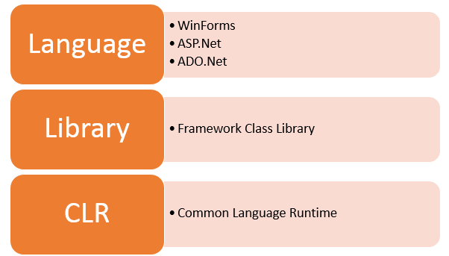
Basic Architecture of .Net

Slide 5
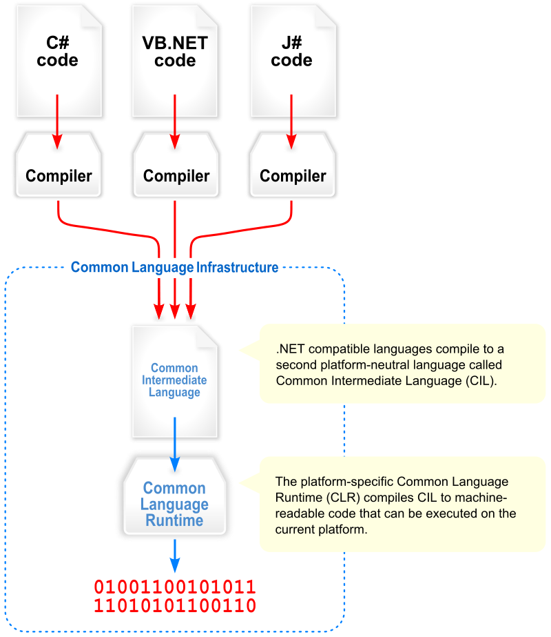
Common Language Infrastructure
Common Language Infrastructure (CLI) provides a language-neutral platform for application development and execution.

Slide 6
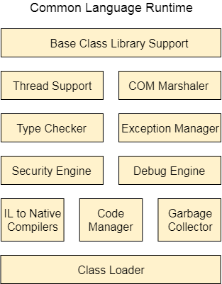
CLR (Common Language Runtime)
It converts It is a program execution engine that loads and executes the program.
the program into native code.
It acts as an interface between the framework and operating system.
It does exception handling, memory management, and garbage collection.

Slide 7
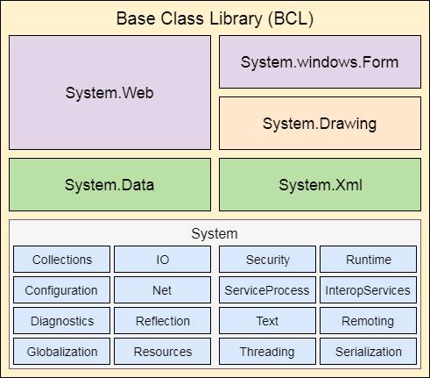
FCL (Framework Class Library)
It is a standard library that is a collection of thousands of classes and used to build an application. The BCL (Base Class Library) is the core of the FCL and provides basic functionalities

Slide 8
Languages
The types of applications that can be built in the .Net framework is classified broadly into the following categories.
WinForms – This is used for developing Forms-based applications, which would run on an end user machine. Notepad is an example of a client-based application.
ASP.Net – This is used for developing web-based applications, which are made to run on any browser such as Internet Explorer, Chrome or Firefox.
ADO.Net – This technology is used to develop applications to interact with Databases such as Oracle or Microsoft SQL Server.

Slide 9
.Net Framework Design Principle
Interoperability
Portability
Security
Memory management
Simplified deployment

Slide 10


